Slide 1
Sentiment Analysis

Slide 2
Introduction
Public opinions may not be the only factor driving the markets, but it’s unquestionably significant.
Many computational techniques have been developed to measure and use “public opinions” to predict market movement. One such technique is Sentiment Analysis, which fusions machine learning (ML) and natural language processing (NLP).
It is an application of ML, or more precisely, it is a classification problem: Given a document, classify it into one of two classes (positive, negative).
It is an application of NLP: We need to “understand” the documents.
With the real-time information available to us on massive social media platforms like Twitter, SA becomes very successful.

Slide 3
A Traditional Approach
Text Input
Tokenization
Stop word filtering
Negation handling
Stemming
Classification

Slide 4
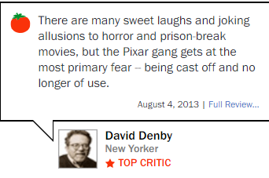
General steps
Text Input

Slide 5
General steps
Text Input
Tokenization
[‘There’, ‘are’, ‘many’, ‘sweet’, ‘laughs’, ‘and’, ‘joking’, … ]

Slide 6
General steps
Text Input
Tokenization
[‘I’, ‘love’, ‘this’, ‘movie’, ‘it’, ‘sweet’, …
Stopwords filtering
Stop words are a set of most commonly used words in a language. They usually do not convey very important information on the semantic of a sentence.
Examples of stopwords: are, and, am, at, be, but, so, such, then, …

Slide 7
General steps
Text Input
Tokenization
Stopwords filtering
Negation handling
It is not bored: “not bored” is opposite of “bored”.

Slide 8
General steps
Text Input
Tokenization
Stopwords filtering
Negation handling
It is not bored: “not bored” is opposite of “bored”.
Stemming
Reduce words with same stem to a common form.
Examples: wait, waits, waiting, waited ➔ wait

Slide 9
General steps
Text Input
Tokenization
Stop word filtering
Negation handling
Stemming
Classification

Slide 10

Classification
Input:
A document: a long sequence of “words” after the previous preprocessing.
A fixed set of classes C = { c₁, c₂, …, c_{n} }.
Output:
A predicted class c ∈ C.
Can be treated as ML problem:
(d₁, c₁)
(d₂, c₂)
…
(d_{n}, c_{n})
Model building
algorithm
Model
c
Training data
set
d

Slide 11
Classification
Input:
A document: a long sequence of “words”.
A fixed set of classes C = { c₁, c₂, …, c_{n} }.
Output:
A predicted class c ∈ C.
Can be treated as ML problem:
(d₁, c₁)
(d₂, c₂)
…
(d_{n}, c_{n})
Model building
algorithm
Model
c
Training data
set
d

Slide 12
An example
Implementing a classification model for sentiment analysis of movie-reviews

Slide 13

Determining the input
What should be the input? (Since we are using simpler, traditional method here, just simply input the whole doc won’t give good results)
We need to determine some representation of the input so that our model building algorithm can extract the most important and useful information from the training data set to build an effective model.
Key observation:
For Sentiment Analysis, not all the words in the document convey the sentiment of the document.
Look for and focus on those words that convey sentiment.
+ve: sweet, laugh, joke
-ve: horror, fear, cast-off

Slide 14
Determine the input
Input representation for SA
Determine a list of “important” sentiment words: “good”, “attractive”, “rubbish”,…. We call this list “words_features”
To construct an input representation for a document, check for each word in the words_features set, whether the document contains that word.
Document1:
‘good’ | ‘attractive’ | ‘rubbish’ | …
True | True | False

Slide 15
Feature engineering
The training set for this supervised learning task:
Document1:
‘good’ | ‘attractive’ | ‘rubbish’ | …
True | True | False
, pos
Document2:
‘good’ | ‘attractive’ | ‘rubbish’ | …
False | False | True
, neg
…
Document_n:
‘good’ | ‘attractive’ | ‘rubbish’ | …
False | True | True
, neg

Slide 16
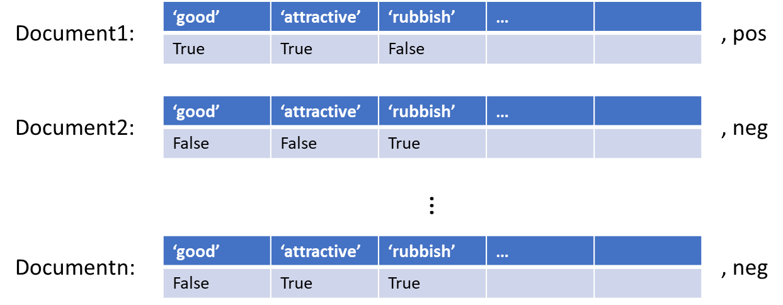
The model building process
Model building
algorithm
Model
pos
Test document
‘good’ | ‘attractive’ | ‘rubbish’ | …
True | False | False

Slide 17
Apply this idea: movie-reviews from NLTK
NLTK is a suite of libraries and Pythons programs for natural language processing (NPL) for English.
It is developed by researchers at the University of Pennsylvania, and is intended to support research and teaching in NLP.

Slide 18
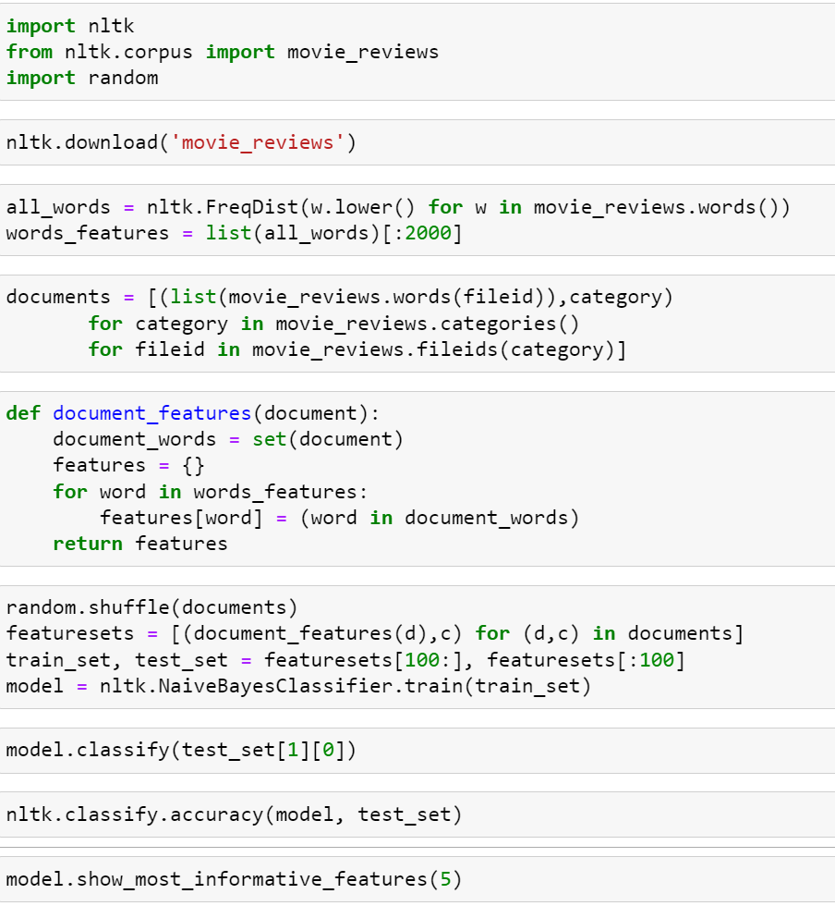

Slide 20
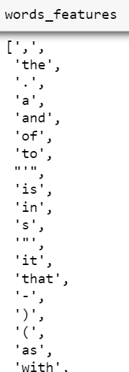

Slide 21
The top 2000 more
Commonly used ‘words’
In the movie reviews.

Slide 22
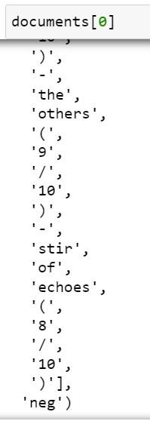
A list of tuples
like this one

Slide 23
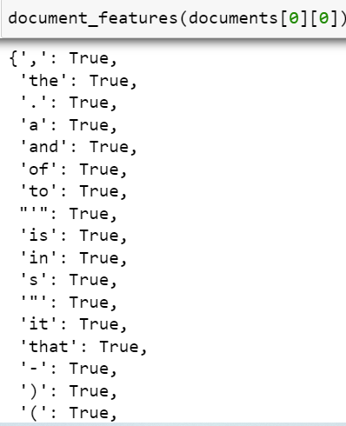

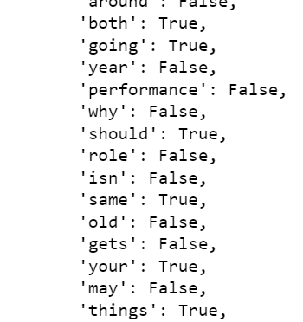

Slide 25
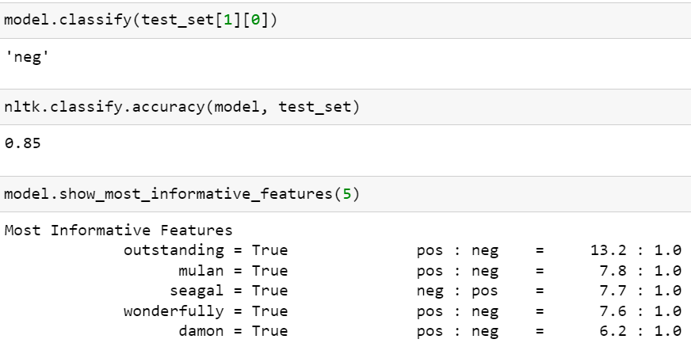

Slide 26
Advanced NLP tools for SA
Transformer: A deep neural network architecture that finds applications in NLP, Computer vision, multi-modal processing,…

Slide 27
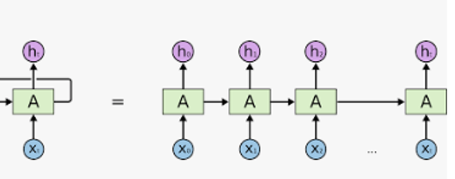
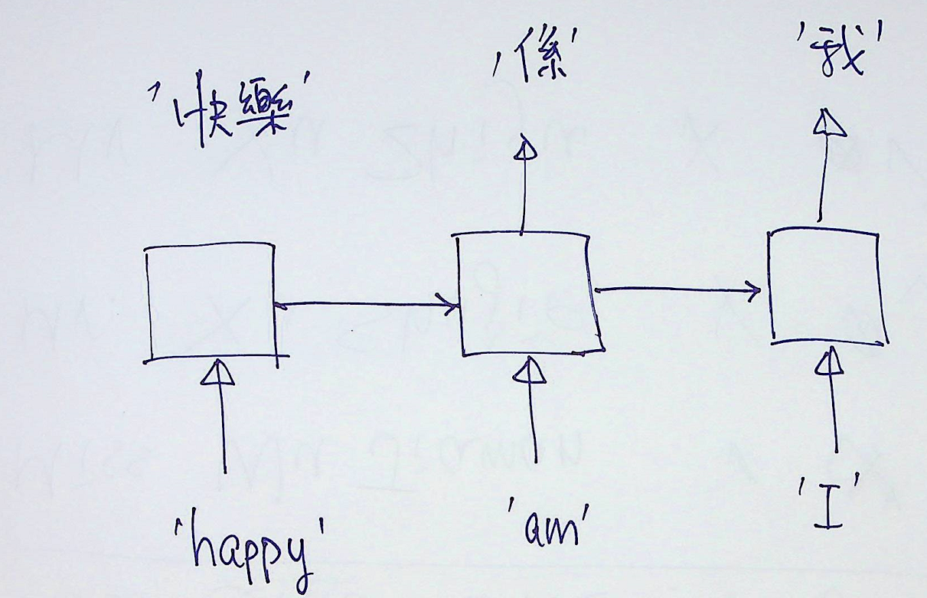
A very over-simplified view on NLP
In essence, NLP is time-series analysis
Time series analysis using LSTM
NLP: A few years ago, we used to use LSTM

Slide 28
Transformer in NLP
But LSTM, and other traditional models for NLP, fell short when it came to handling long-range dependencies (which is essential to translate a long and complex sentence).
Transformer solves this difficult problem by introducing the “technique of attention”, which helps us relate different positions of a single sequence in order to compute a representation of the sequence.
It is a deep neural network architecture that aims to solve sequence-to-sequence tasks (NLP is a sequence-to-sequence tasks).

Slide 29
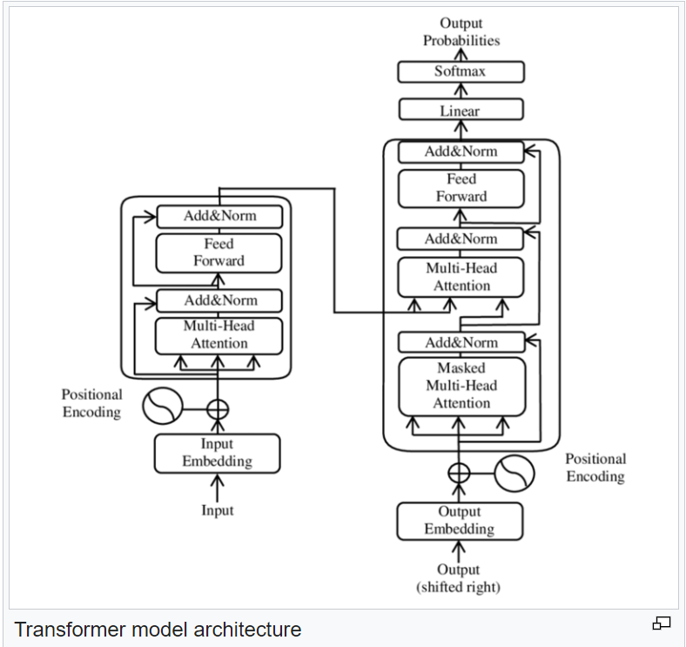
Transformer in NLP
Transformer is a deep neural network architecture that aims to solve sequence-to-sequence tasks (NLP is a sequence-to-sequence tasks).
Note: You don’t need to remember this architecture.

Slide 30
Based on Transformer, we have ChatGPT
Many studies showed that GhatGPT is the most accurate sentiment analyzer
ChatGPT significantly outperforms ML models regardless of the amount of training data provided. However, the ChatGPT API is also much slower than a traditional ML model due to the popularity of ChatGPT / GPT-4. A single example usually took 4–5 seconds to process, whereas traditional ML models are many times faster (once trained and tuned.)

Slide 31
ChatGPT
ChatGPT (Chat Generative Pre-trained Transformer) is a NLP tool (indeed, it’s a chatbot) developed by OpenAI and launched in November 2022.
OpenAI used data labeling services such as Scale AI and workers in Kenya to prepare the training data.
ChatGPT is based on Transformer. Its success of ChatGPT comes from three key components:
training data,
massive computing resources, and
model scale

Slide 32
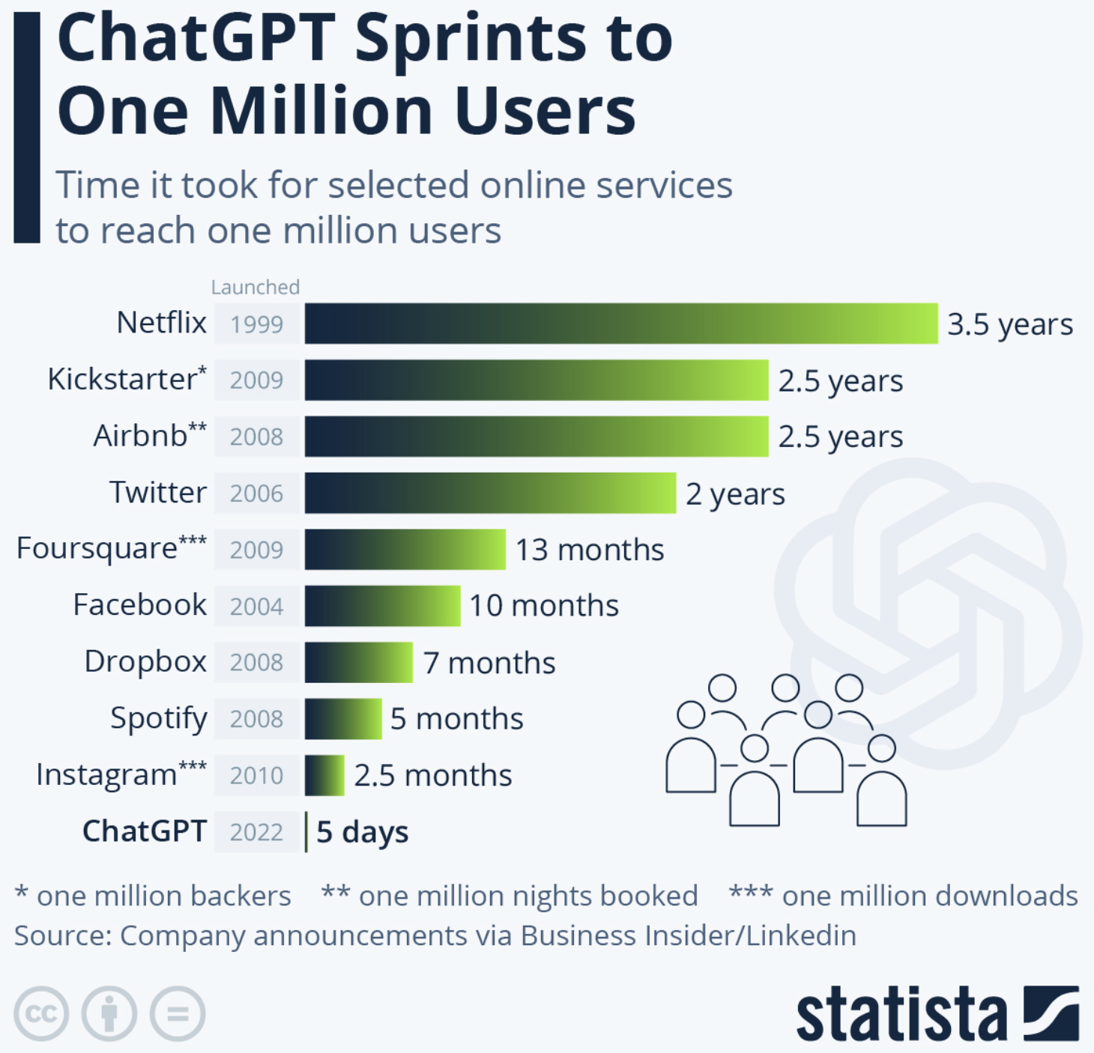
ChatGPT
ChatGPT gained 1 million users in only 5 days and
over 100 million monthly active users within just two months of its launch.

Slide 33
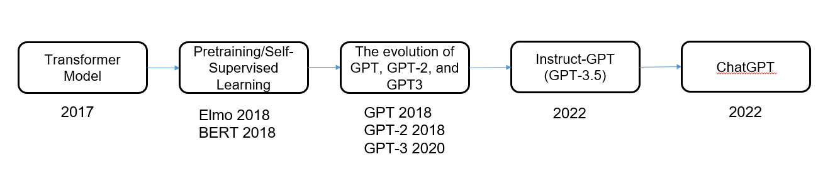
ChatGPT
The history for the technologies that enabled ChatGPT

Slide 34
ChatGPT: Self-supervise learning
Self-supervised learning: A very interesting trick to blow up the size of the training data without any extra manual effort.
It lets the model train itself by learning one part of the input from another part of the input.
How?
High-level idea
Given a training input, which sequence of tokens, we “randomly” mask off some of the tokens, and this create a new training data: the sequence with the mask token, and the label is the sequence of masked token.

Slide 35
The Evolution of GPT of OpenAI
GPT models of OpenAI
GPT-1: Improving Language Understanding by Generative Pre-Training. OpenAI. 2018.
GPT-2: Language Models are Unsupervised Multitask Learners. OpenAI. 2018.
GPT-3: Language Models are Few-Shot Learners. OpenAI. 2020.
GPT-1 first uses the language model objective to pretrain Transformer, then finetunes the model on each downstream task.
GPT-1 has 117 million parameters
GPT-2
Larger model size: The largest GPT-2 model has 1.5 billion parameters
More diverse data on the Web
Zero-shot task transfer
Data source: WebText:
The outbound links from Reddit.
A total of 40 GB of text

Slide 36
GPT-3
Even larger model size: The largest GPT-3 model has 175 billion parameters
More data from the Web
Few-shot learning: a natural language instruction + a few examples without finetuning
Data source:
CommonCrawl, WebText2, Books1, Books2, and Wikipedia
About 500 billion tokens; a total of 750+GB of text
The text completion ability of GPT-3 is stronger than GPT-1 and GPT-2.
Starting from GPT-3, OpenAI stops open-sourcing and just provides the APIs.
Overall speaking, the GPT models are trained longer, use more diverse data, and scale the model size.

Slide 37
Flair: A NLP (Natural Language Processing) tool that supports SA
Flair is a simple but powerful NLP library for building ML models for text classification and speech recognition.
In the following example, we use its pre-trained text classifier ‘en-sentiment’, which accepts a sequence of letters as input, and outputs its sentiment, either POSITIVE or NEGATIVE with “confidence level” (in term of probability). (I.e., translating an English sentence to a sentence of language with only two valid sentence: “Pos” and “Neg”)
The example also illustrates how to use the API of twitter to get tweets from twitter, and use our program to decide the sentiment of these tweets.

Slide 38
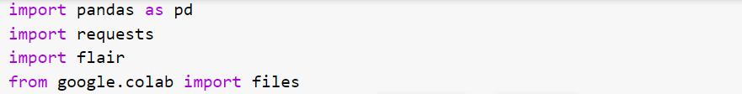
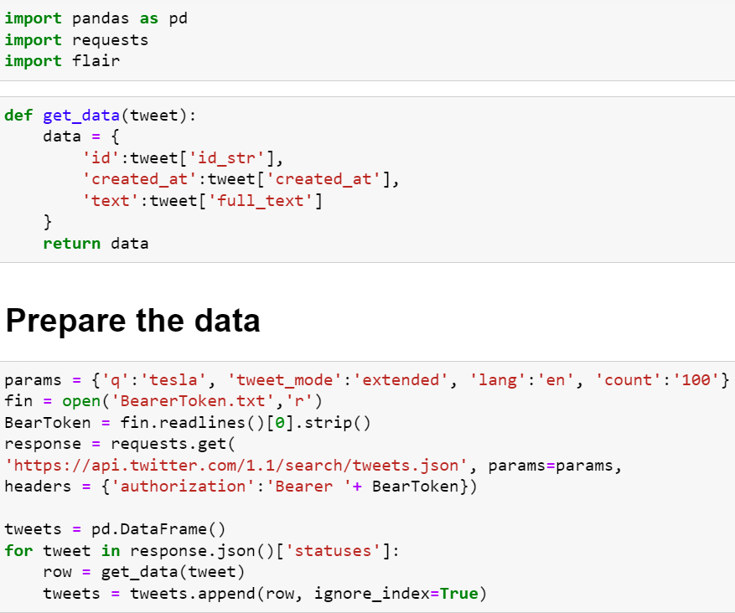

Slide 40
“password” for access twitter. You need to be a “Developer” in order to get a Bear Token. More details can be found in
dev.twitter.com

Slide 41
The API

Slide 42
.json() convert the API response
into a Ptyhon dictionary through
the JSON file format.
JSON (JavaScript Object Notation) is
a popular data interchange format.

Slide 43
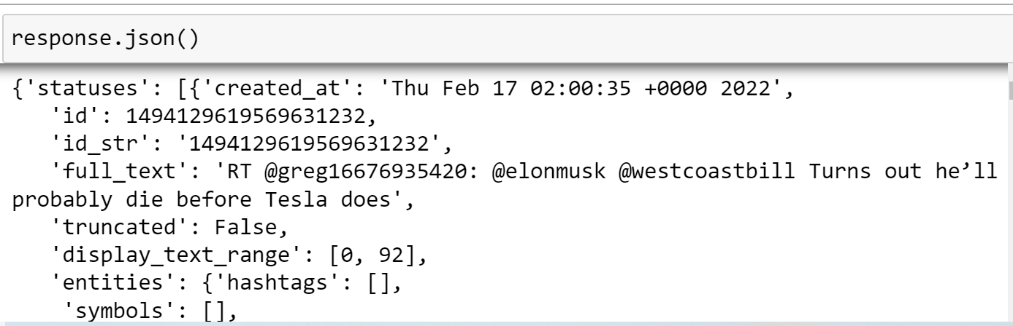
A list of dictionaries, one for a tweet.

Slide 44
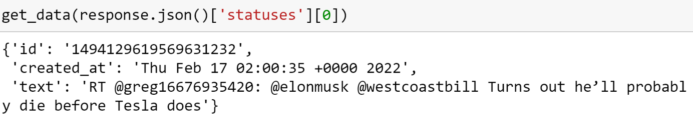

Slide 45
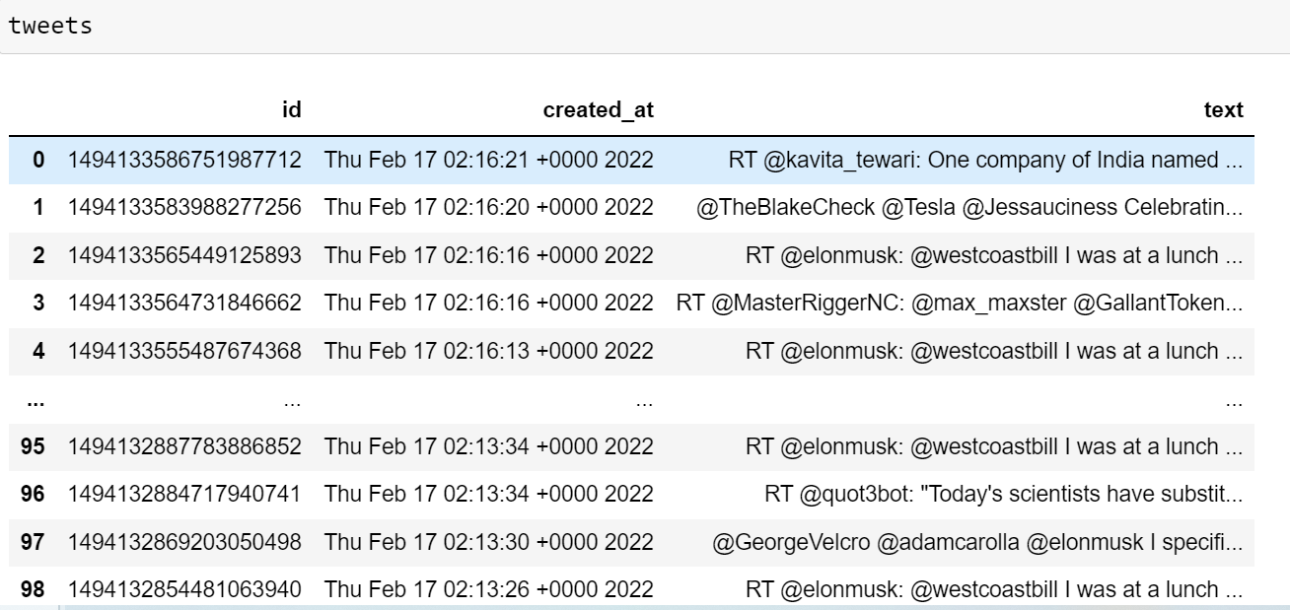

Slide 46
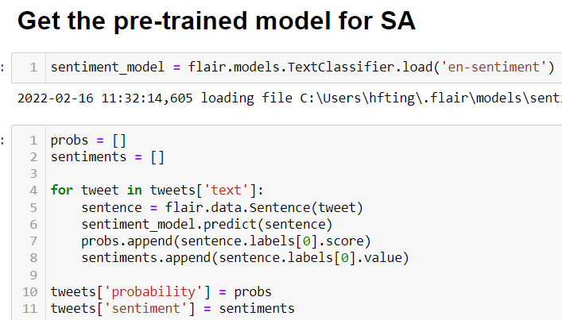

Slide 47
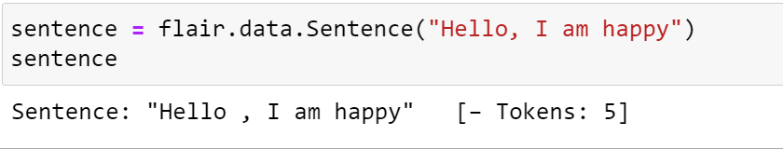
Convert to flair format. Roughly
speaking, it’s just tokenization.

Slide 48
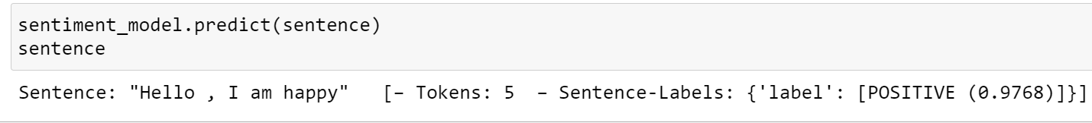
Convert to flair format. Roughly
speaking, it’s just tokenization.

Slide 49
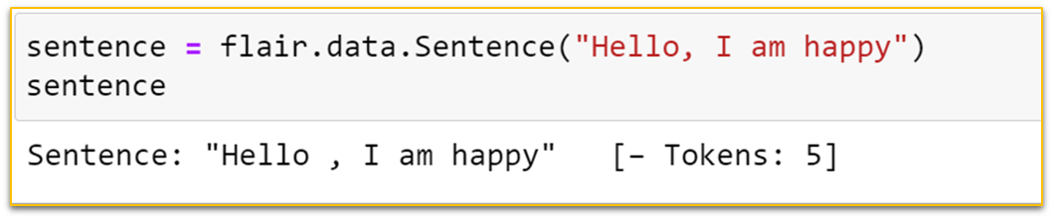
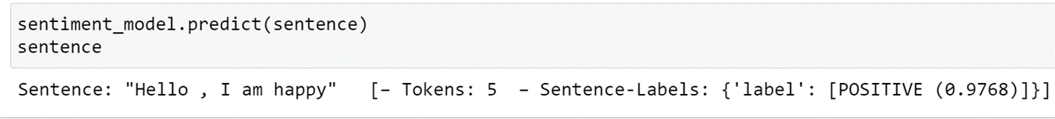

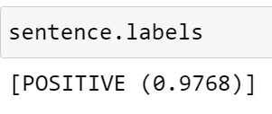
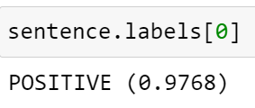

Slide 50
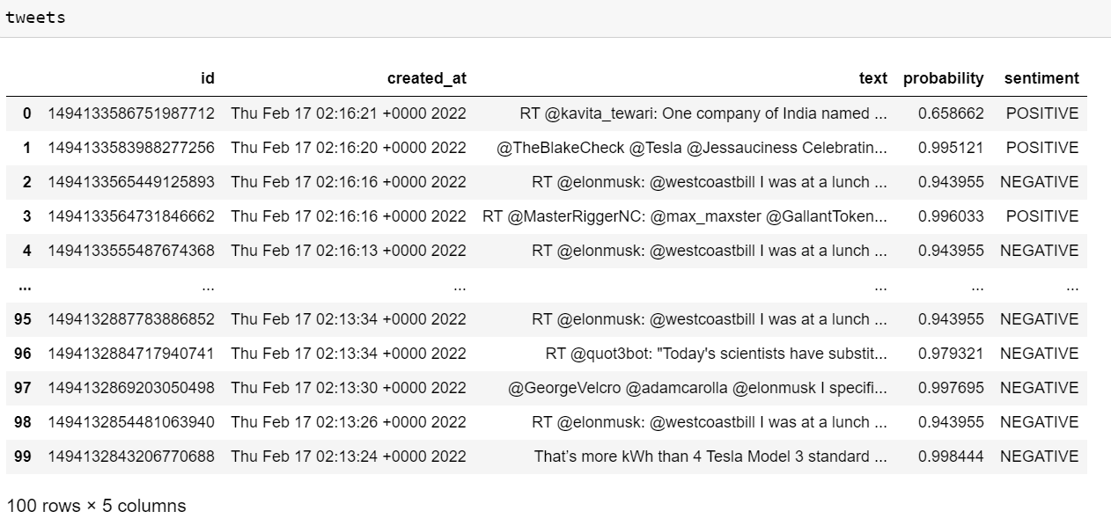

Slide 51
Now, let us relate sentiment with stock prices

Slide 52
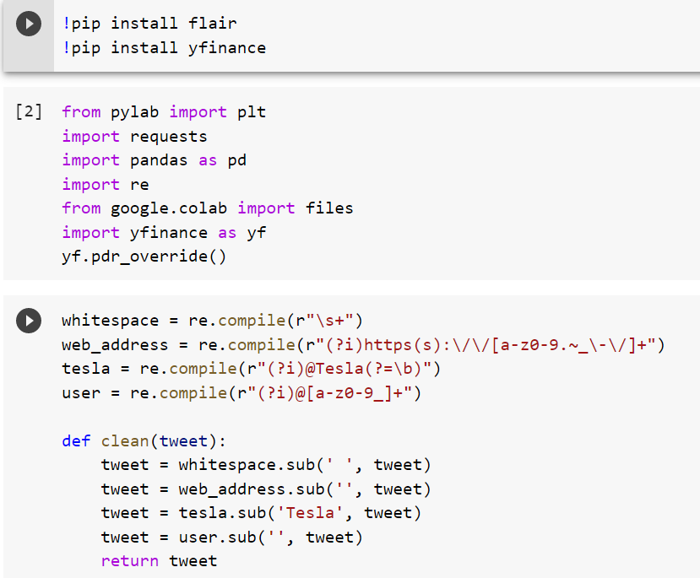
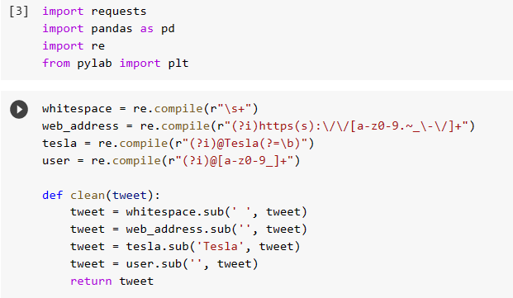

Slide 53
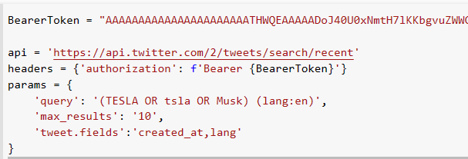

Slide 54
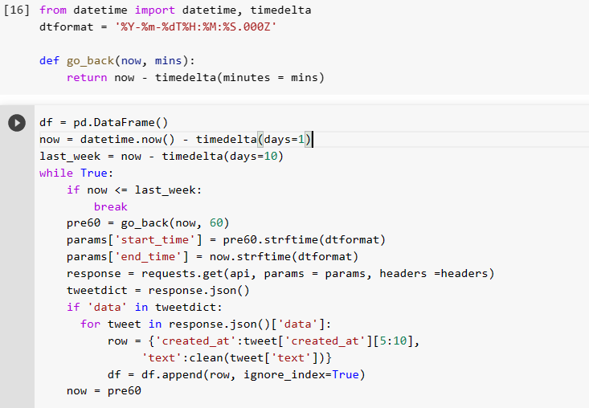

Slide 55
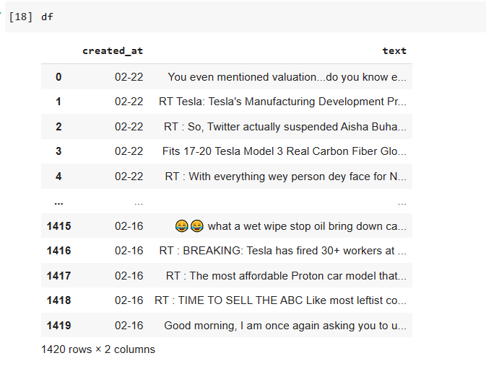

Slide 56
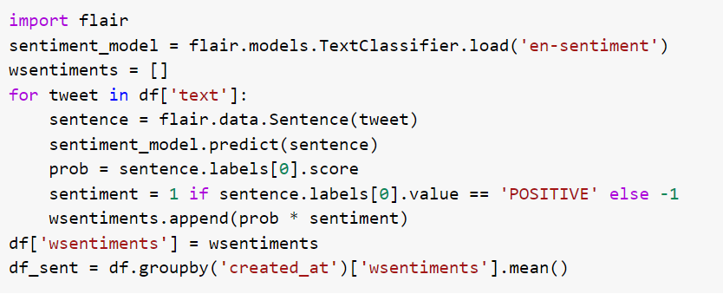

Slide 57
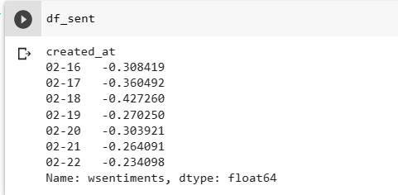

Slide 58
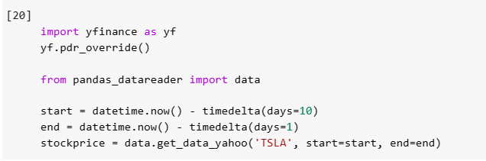
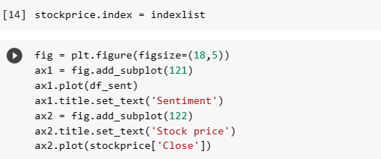

Slide 59
